Slide 1
Fall detection notification via SMS and Email
DGMD-14 | Tony Hua | Devin Anderson | A.J. Ikene | Luis Villa | Lou Zhiyuan

Slide 2
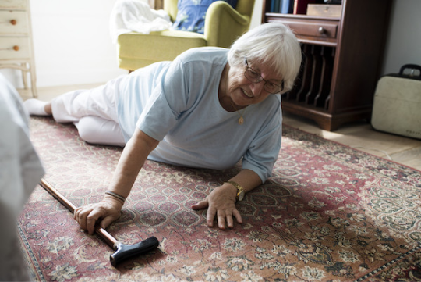
36 million falls are reported each year amongst elderly adults.
14.7 million live alone.
Notes:
Devin

Slide 3
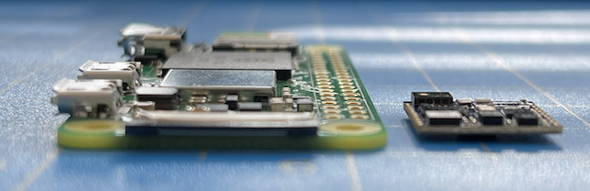
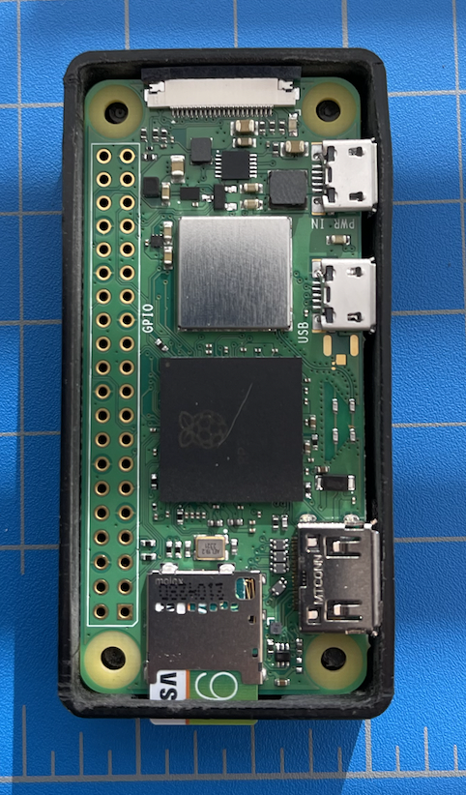
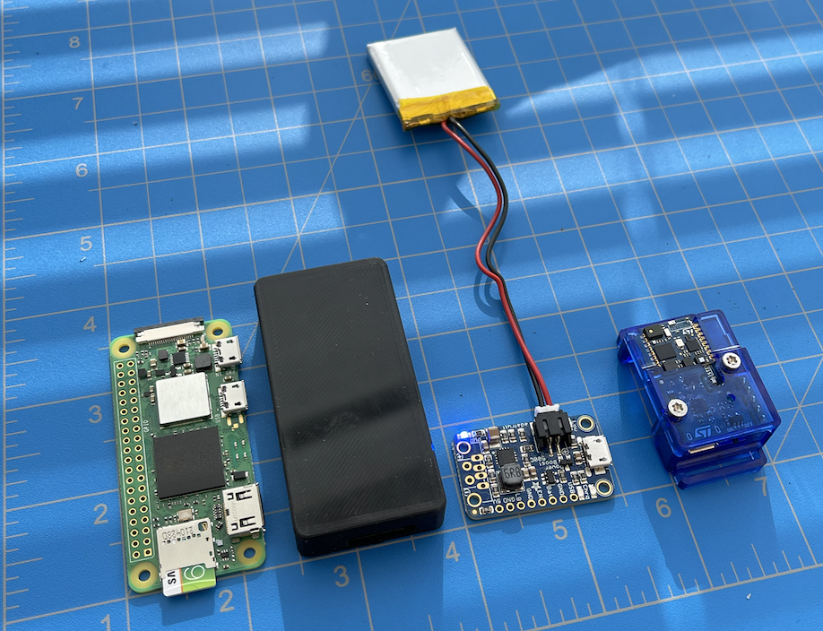
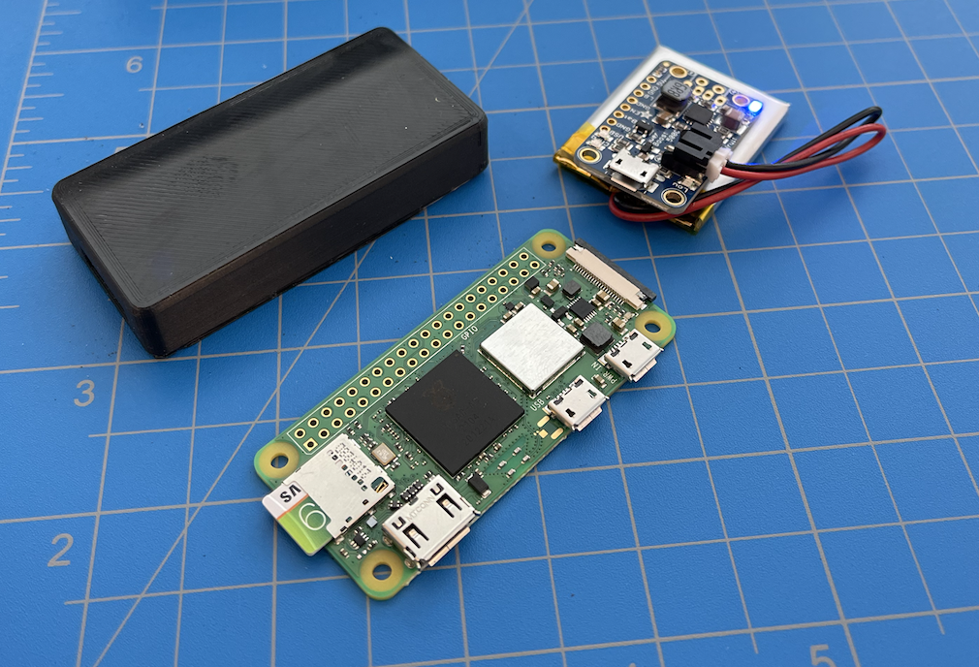
Prototype solution
A wearable device that detect falls, and alert loved ones or emergency responders when an event occurs.
Easy to set up.
No buttons required.
Notes:
Devin

Slide 4



How it works
How it works
Users wear the device
A fall is detected
SMS text alert is sent
Notes:
Tony

Slide 5
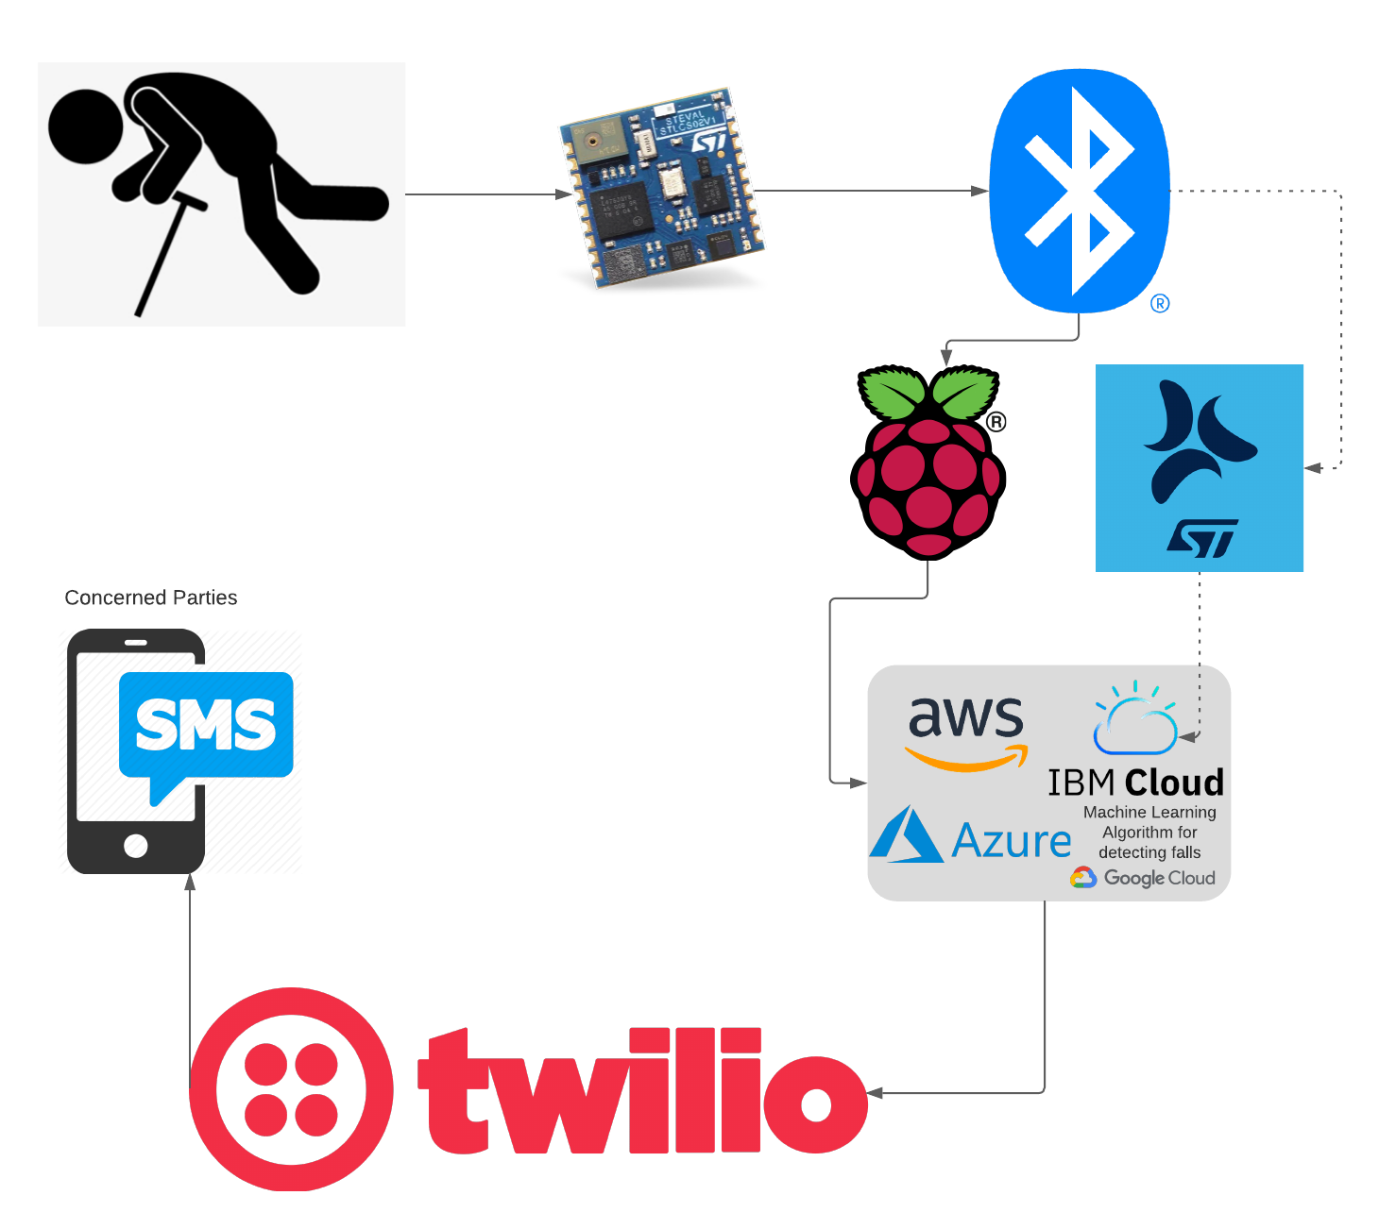
Technical Overview
Technologies used
SensorTile
Firmware Installed: ALLMEMS1
For Development, we used the Cradle Expansion Board connected to USB
Raspberry Pi 4
Operating System for Raspberry Pi: New Out of The Box Software
Software Development Kit
BlueST Software Development Kit - Python
GitHub Link
Twilio
Had to setup a Twilio account to enable sending messages to multiple devices (SMS, Email, Voice Message)
Flow diagram
Notes:
Tony

Slide 6
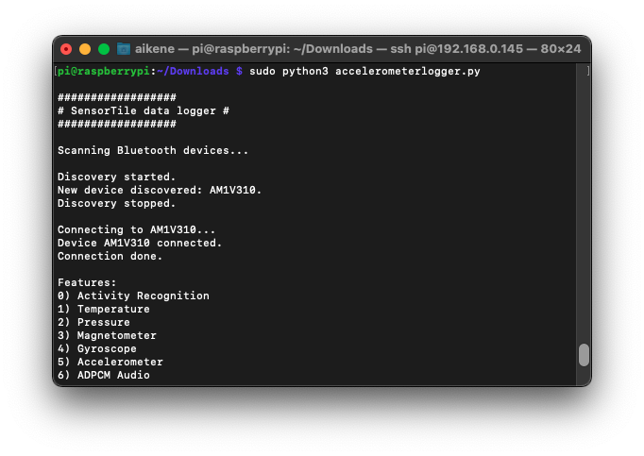
Connecting SensorTile to Raspberry Pi via Python
Use Manager Class (as a part of Python SDK) to SensorTile using MAC Address
Additional Python Modules needed
Bluepy
Blue-st-sdk
Futures
Twilio
Notes:
AJ

Slide 7
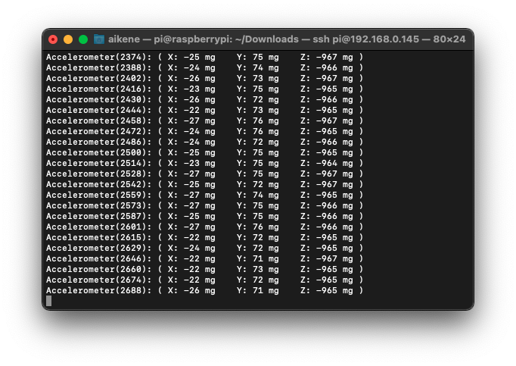
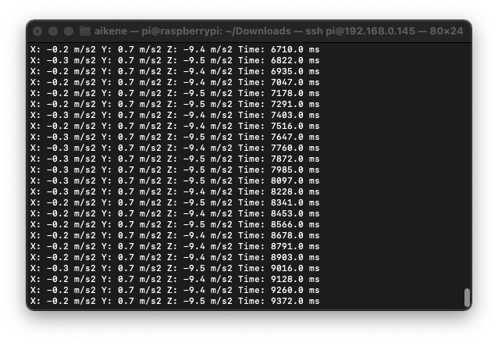
Parsing data outputted by Blue ST SDK
How data is displayed by default using Blue ST SDK_Python
Displayed in g-unit -> wanted to display in meter/s^2
Wanted to be able to parse this data and write to a csv/text file
Wanted to add timestamp variable for each measurement
Notes:
AJ

Slide 8
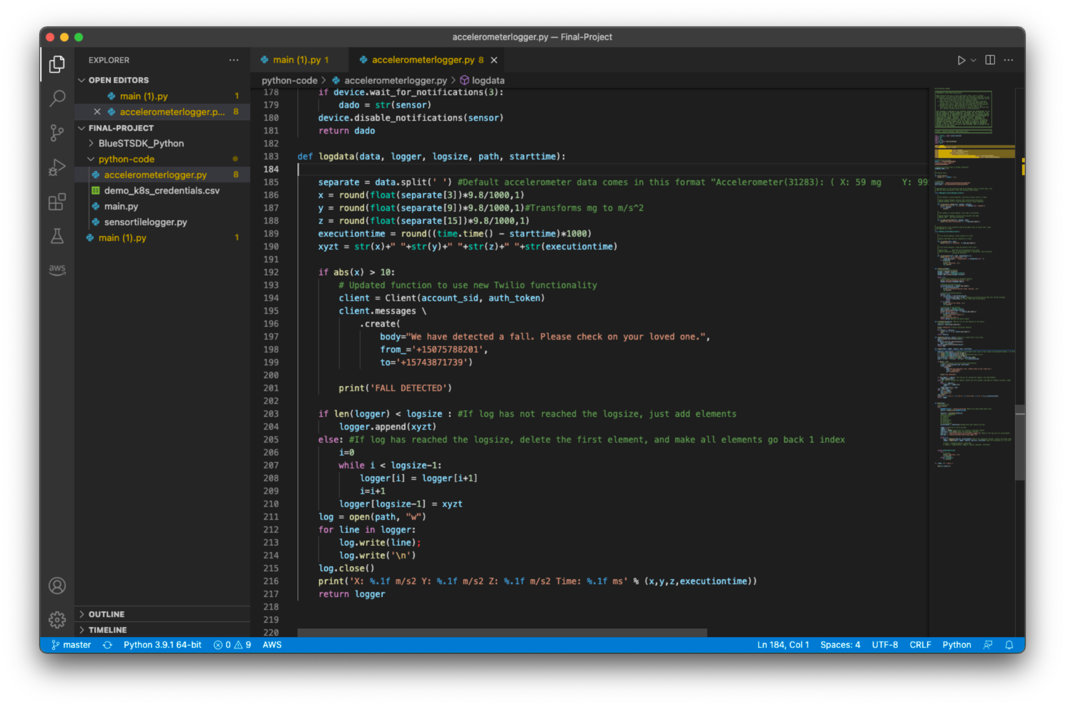
Send a message when ML classified fall acceleration threshold is triggered
When acceleration threshold is met
print(‘Fall Detected’)
Send text message
Notes:
AJ

Slide 9
Live demo
A skit, by Devin and AJ
Notes:
AJ and Devin

Slide 10
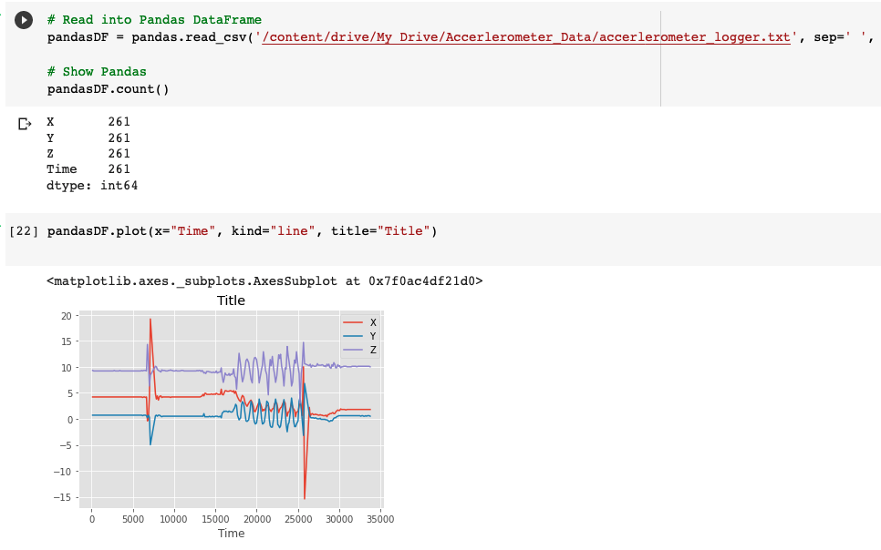
Visualizing Data in Python Notebook
Link to Visualized Data
Notes:
Luis

Slide 11
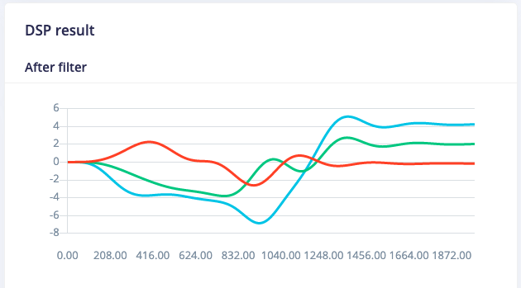
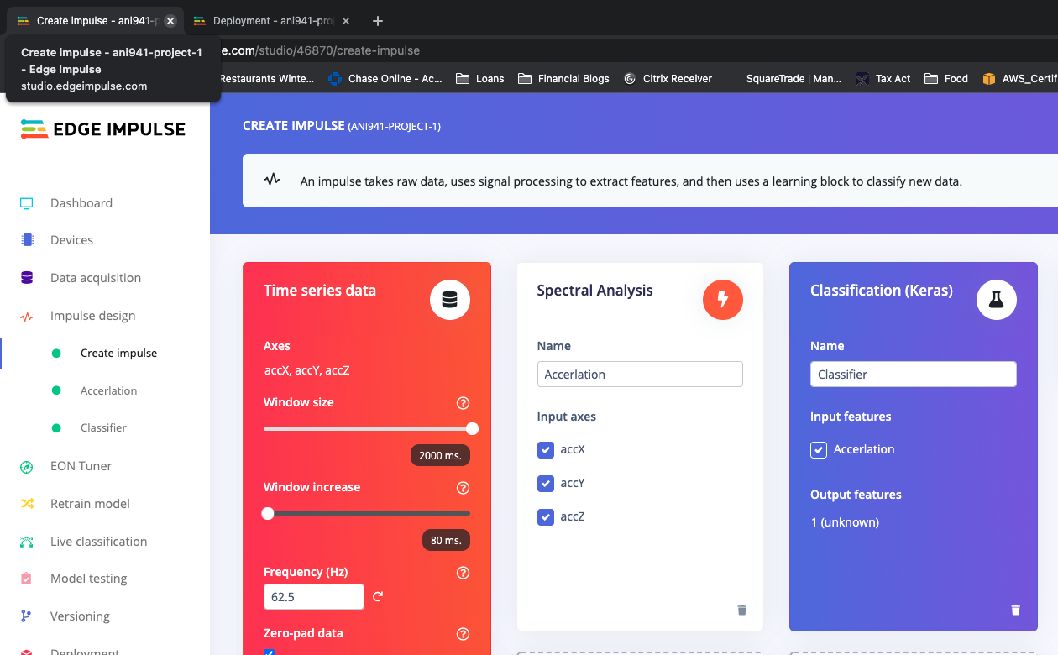
Machine Learning Classification using Edge Impulse
Link to Training Model
Notes:
Luis

Slide 12
Conclusion & future work
Notes:
Tony

Slide 13
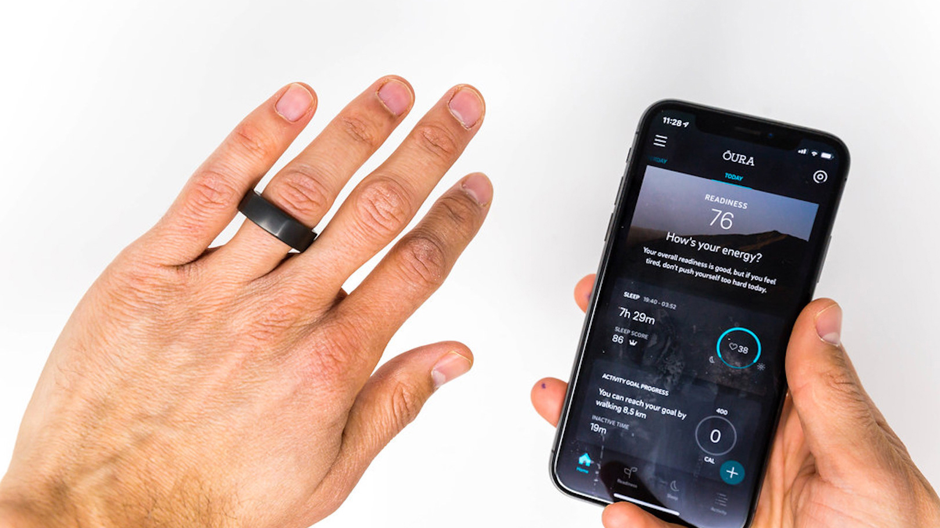
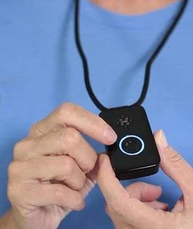
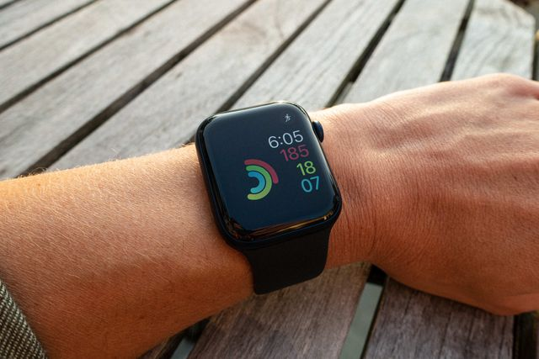
Fall detection alerts can be accomplished affordably with embedded ML.
Notes:
Tony

Slide 14
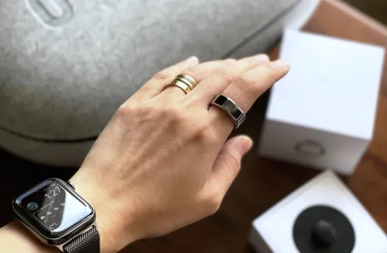
Packaging as a wearable device
Next step
Create a portable cradle for SensorTile
Notes:
Luis / Tony

Slide 15
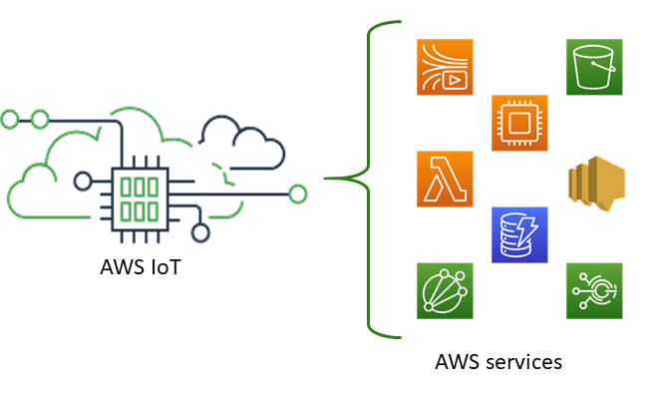
Create an AWS iOT Node
Next step
Enables more cloud connected options for alerts and workflows
Notes:
Tony

Slide 16
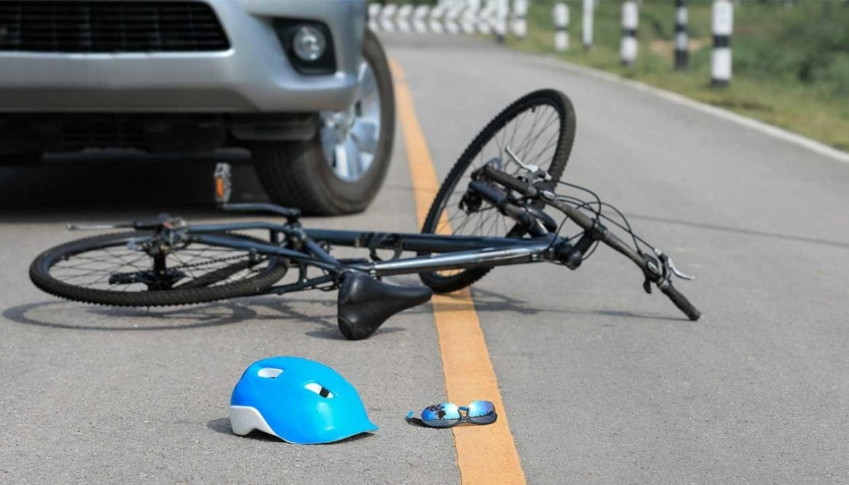
Additional machine learning classifications
Next step
In addition to fall detection, ML classification can accurately detect other critical states such as biking accidents, for example.
Notes:
Tony

Slide 17
References
https://learn.adafruit.com/adafruits-raspberry-pi-lesson-6-using-ssh/using-ssh-on-a-mac-or-linux
https://www.ncbi.nlm.nih.gov/pmc/articles/PMC4346101/
https://github.com/twilio/twilio-python/issues/412
https://www.hackster.io/felipsz/sensortile-sensor-data-monitoring-using-a-raspberry-pi-7a3663#toc-lets-connect-our-rpi-to-the-sensortile-4
https://www.cdc.gov/injury/features/older-adult-falls/index.html#:~:text=About%2036%20million%20falls%20are,bones%20or%20a%20head%20injury.
https://www.pewresearch.org/fact-tank/2020/03/10/older-people-are-more-likely-to-live-alone-in-the-u-s-than-elsewhere-in-the-world/
Notes:
Tony

